Slide 1
NWEA: MAP Assessments
Spring 2025 Score Report

Slide 2
NWEA MAP: 9th and 10th Grade Reading

Slide 3
NWEA MAP: 9th and 10th Grade Math

Slide 4
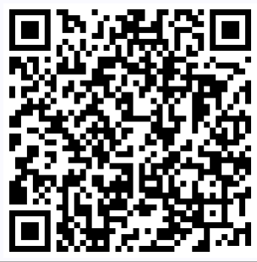
NEW! Georgia's K-12 English Language Arts (ELA) Standards
Implementation in the 2025-26 school year, for Grades K-12

Slide 5
English Language Arts Pathways to Postsecondary Georgia offers a variety of graduation pathways to satisfy state English language arts requirements while meeting the needs and interests of students. Additional pathways may continue to be developed and added to course options. Local school districts have the flexibility to offer accelerated models that best meet the needs of their school communities.

Slide 6
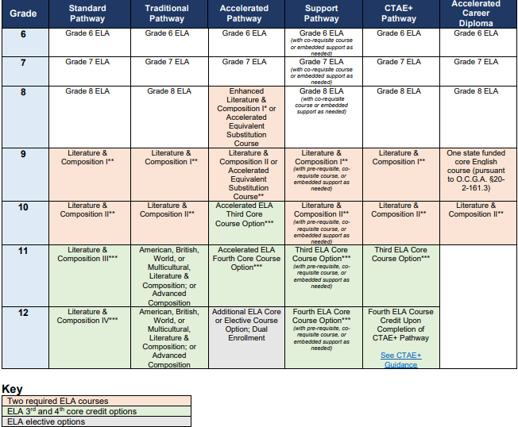

Slide 7
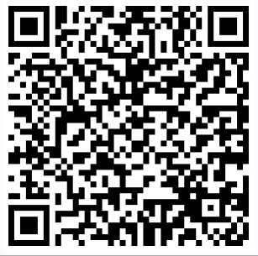
GMAS Updates:
The following grades will participate in Georgia Milestones Assessment System (GMAS):
Grade(s): 3rd-8th
Grade: 10th
For more information discussing GMAS Updates: (scan QR code)

Slide 8
Announcements:
Spring Break April 7th-April 11th
Prom- April 18^{th @ 7:00 PM}
End of Course Assessments April 28th-May 9th
Visions Ceremony May 16^{th @ 6:00 PM}
^{Graduation May 23rd @ 3: 00 PM}

